Slide 1
ToDo App
By Justin Rebollar
For CodePath

Slide 2
The setup!
Download and Install Android Studio
Download link: https://developer.android.com/studio
Instructions: https://developer.android.com/studio/install.html?pkg=studio
Refresh git knowledge
https://guides.github.com/introduction/git-handbook/

Slide 3
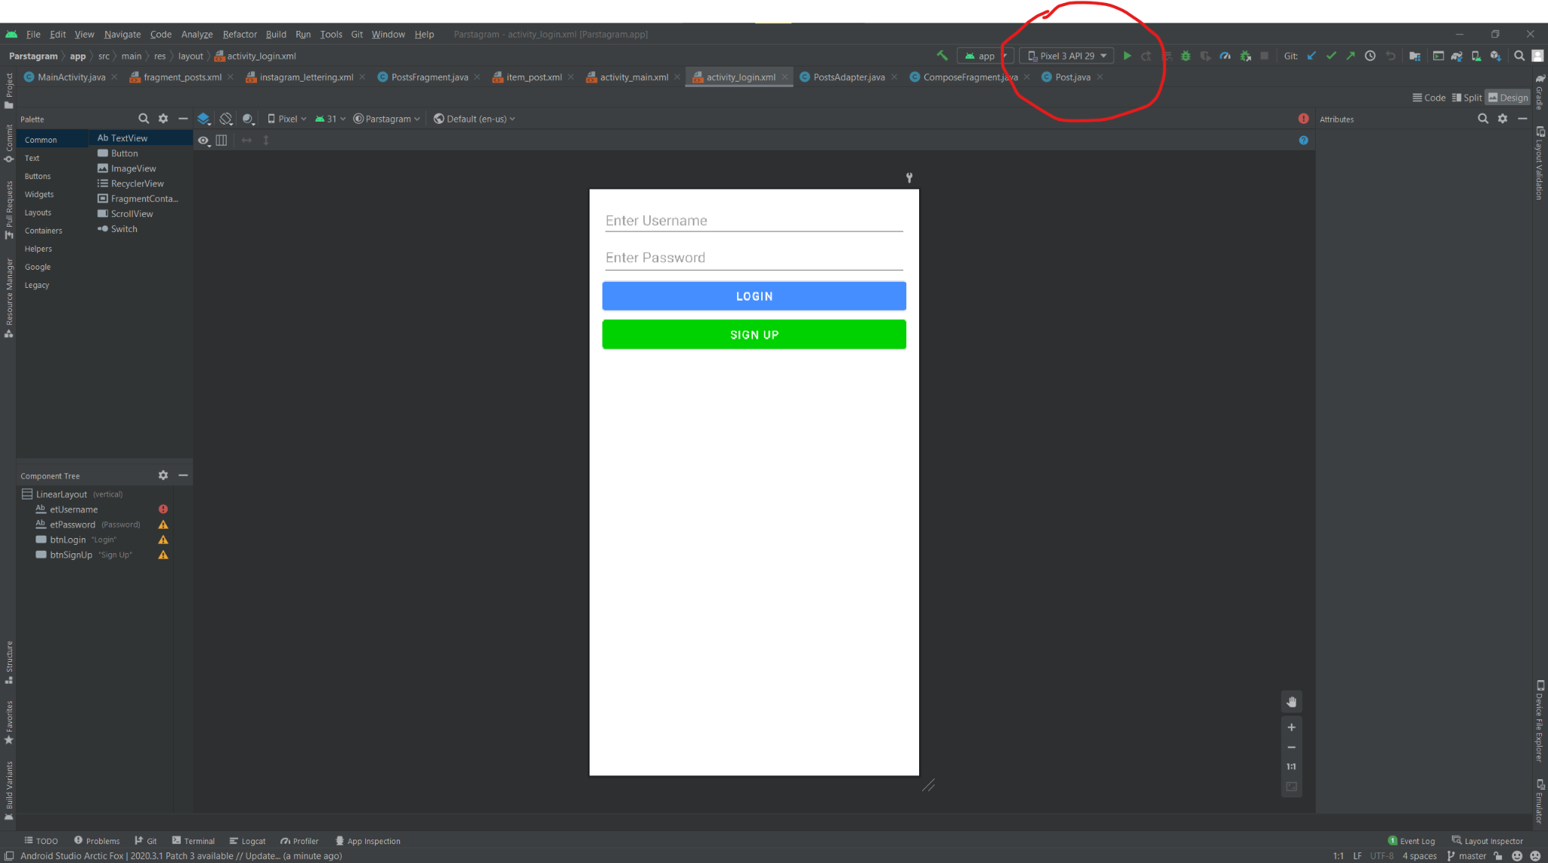
Creating a virtual device
Once you open your Android Studio, in your project, go ahead and click on the AVD manager.
Once in the AVD manager select create virtual device
Go ahead and select your the device you would like as long as it comes equipped with API 29.
API 29 is needed as it is what a majority of android devices support!
Go ahead and click download!

Slide 4
You’re done setting up your Android Studio!

Slide 5
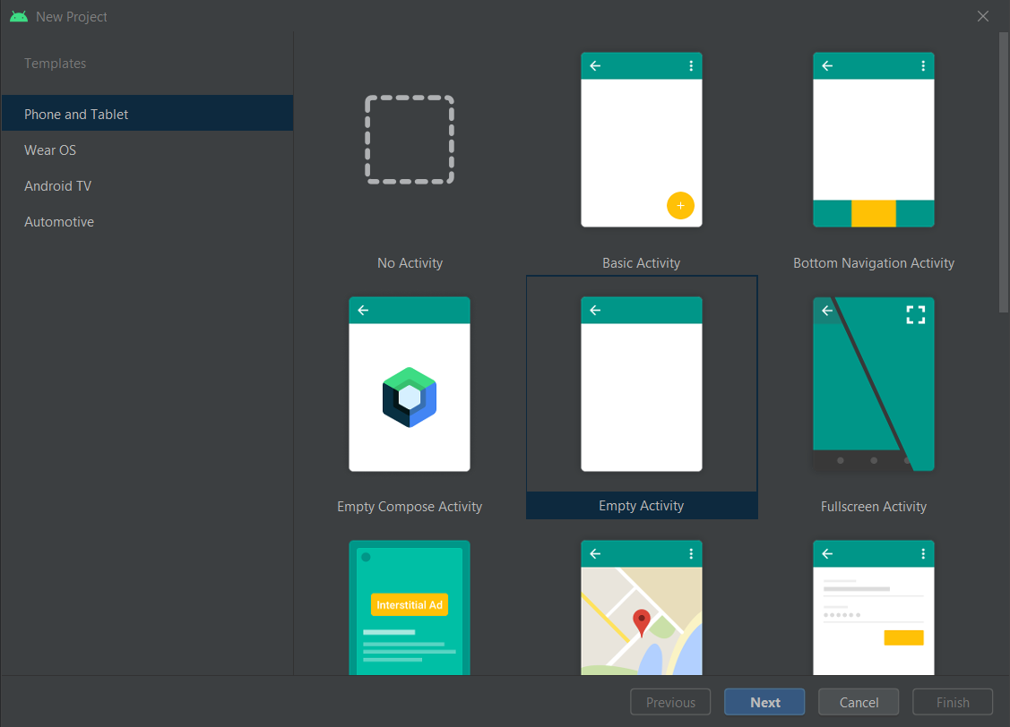
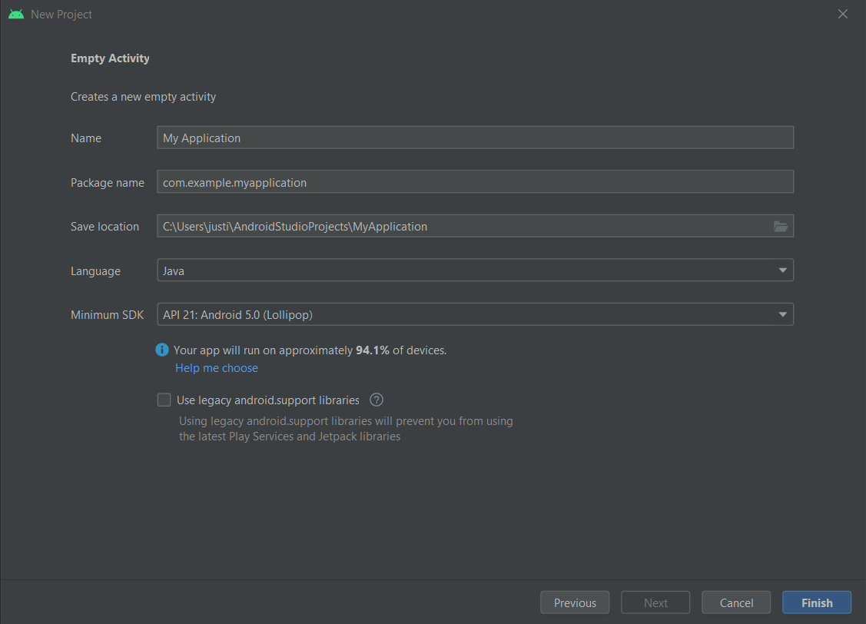
Setting up your project
Select new activity
Empty activity
Go ahead and name your project and leave all other options as default

Slide 6
After watching the walkthroughs

Slide 7
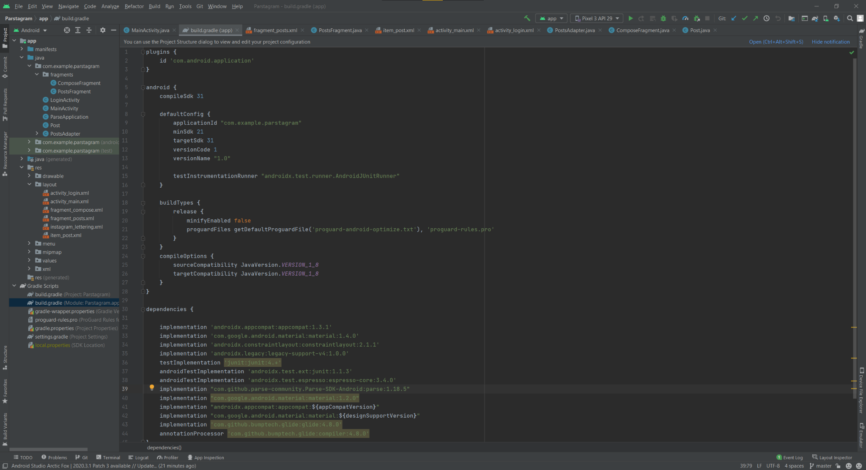
Gradle Build
A system that is used to automate building, testing, deployment, etc.
Scripts that are implemented to help make your program more efficient
Example: Glyde
An image displaying framework!

Slide 8
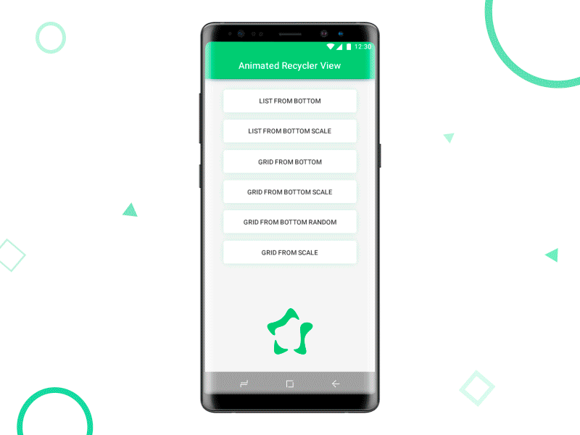
Recycler View
RecyclerView makes it easy to efficiently display large sets of data.
As the name implies, RecyclerView recycles those individual elements. When an item scrolls off the screen, RecyclerView doesn't destroy its view. Instead, RecyclerView reuses the view for new items that have scrolled on screen. This reuse vastly improves performance, improving your app's responsiveness and reducing power consumption.

Slide 9
onCreate()
is where you initialize your activity. Most importantly, here you will usually call setContentView(int) with a layout resource defining your UI, and using findViewById(int) to retrieve the widgets in that UI that you need to interact with programmatically.

Slide 10
onClick()
An onclick attribute must be public, return void, and define a view as its only parameter.
The onClick attribute will communicate button presses on your android app.

Slide 11
Intents
An Intent is a messaging object you can use to request an action from another app component. Although intents facilitate communication between components in several ways, there are three fundamental use cases:

Slide 12
Thank you!

